Slide 1
UNIT – I
Introduction: Basic concept of simple control system – open loop – closed loop control systems. Effect of feedback on overall gain – stability sensitivity and external noise.
Types of feedback control systems – Liner time invariant, time variant systems and nonlinear control systems
Mathematical models and Transfer functions of Physical systems: Differential equations – impulse response and transfer functions – translational and rotational mechanical systems. Transfer functions and open loop and closed loop systems. Block diagram representation of control systems – block diagram algebra – signal flow graph – Mason’s gain formula
Components of control systems: DC servo motor – AC servo motor – synchro transmitter & receiver

Slide 2
Unit – II
Time domain analysis: Standard test signals – step, ramp, parabolic and impulse response function – characteristic polynomial and characteristic equations of feedback systems – transient response of first order and second order systems to standard test signals. Time domain specifications - steady state response – steady state error and error constants. Effect of adding poles and zeros on over shoot, rise time, band width – dominant poles of transfer functions.
Stability analysis in the complex plane: Absolute, relative, conditional, bounded input –bounded output, zero input stability, conditions for stability, Routh –Hurwitz criterion.

Slide 3
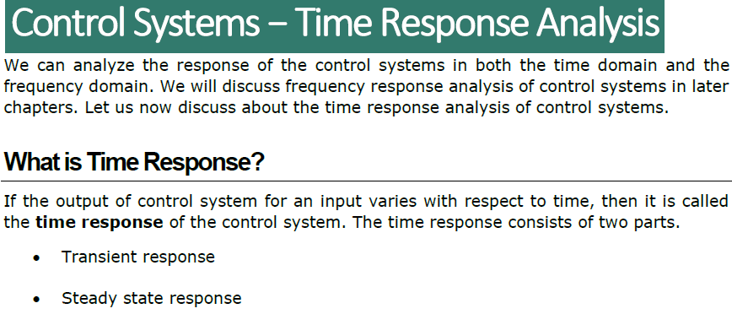

Slide 4
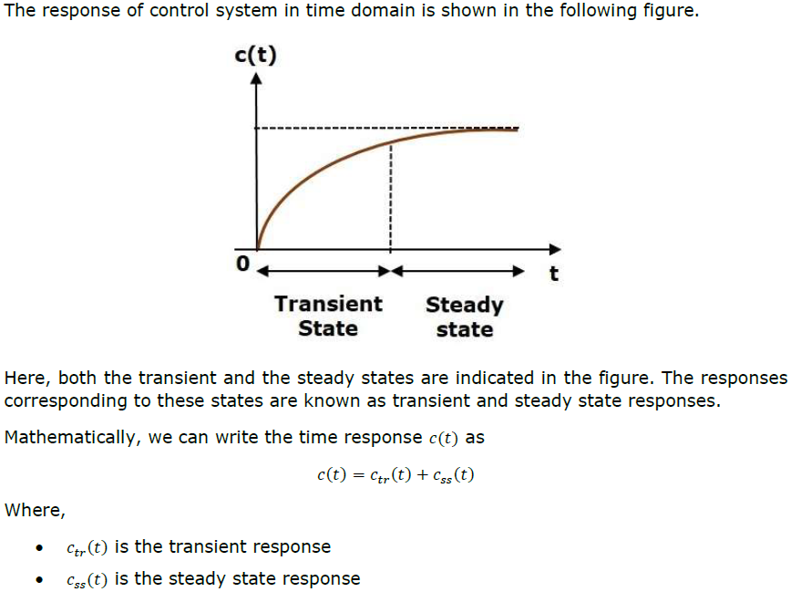

Slide 5
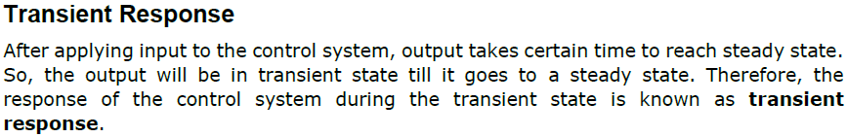
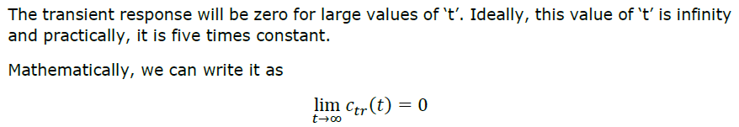
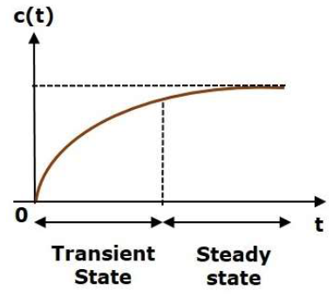

Slide 6
